Slide 1
Module 3
Hashes, Message Digests and Digital Certificates

Slide 2
MESSAGE INTEGRITY
The cryptography systems that we have studied so far provide secrecy, or confidentiality, but not integrity.
However, there are occasions where we may not even need secrecy but instead must have integrity.
For example, Alice may write a will to distribute her estate upon her death. The will does not need to be encrypted.
After her death, anyone can examine the will.
The integrity of the will, however, needs to be preserved. Alice does not want the contents of the will to be changed.

Slide 3
Message and Message Digest
The electronic equivalent of the document and fingerprint pair is the message and digest pair.
To preserve the integrity of a message, the message is passed through an algorithm called a cryptographic hash function.
The function creates a compressed image of the message that can be used like a fingerprint.

Slide 4
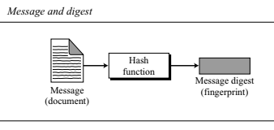

Slide 5
The two pairs (document/fingerprint) and message/ message digest) are similar, with some differences.
The document and fingerprint are physically linked together.
The message and message digest can be unlinked (or sent) separately, and, most importantly, the message digest needs to be safe from change.
The message digest needs to be safe from change.

Slide 6
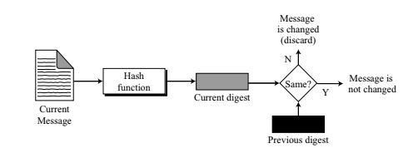
Checking Integrity
To check the integrity of a message, or document, we run the cryptographic hash function again and compare the new message digest with the previous one.
If both are the same, we are sure that the original message has not been changed.

Slide 7
Requirements for Hash Functions
Can be applied to any sized message M
Produces fixed-length output h
It is easy to compute h=H(M) for any message M
given h is infeasible to find x s.t. H(x)=h
one-way property
given x is infeasible to find y s.t. H(y)=H(x)
weak collision resistance
is infeasible to find any x,y s.t. H(y)=H(x)
strong collision resistance
Notes:
7
The purpose of a hash function is to produce a “fingerprint”of a file, message, or other block of data.
These are the specifications for good hash functions. Essentially it must be extremely difficult to find 2 messages with the same hash, and the hash should not be related to the message in any obvious way (ie it should be a complex non-linear function of the message). There are quite a few similarities in the evolution of hash functions & block ciphers, and in the evolution of the design requirements on both.

Slide 8
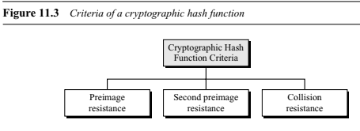
Cryptographic Hash Function Criteria
A cryptographic hash function must satisfy three criteria:
preimage resistance,
second preimage resistance,
and collision resistance,

Slide 9
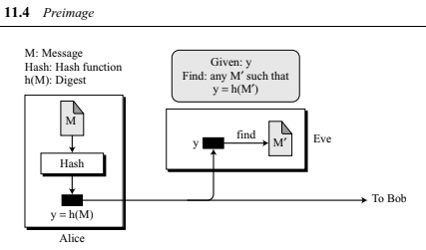
Preimage Resistance
A cryptographic hash function must be preimage resistant.
Given a hash function h and y = h(M), it must be extremely difficult for Eve to find any message, M′, such that y = h(M′).

Slide 10

If the hash function is not preimage resistant, Eve can intercept the digest h(M) and create a message M′.
Eve can then send M′ to Bob pretending it is M.
A checksum function is not preimage resistant, Eve may find several messages whose checksum matches the given one.

Slide 11
Second Preimage Resistance
The second criterion, second preimage resistance, ensures that a message cannot easily be forged.
If Alice creates a message and a digest and sends both to Bob, this criterion ensures that Eve cannot easily create another message that hashes to the exact same digest.
In other words, given a specific message and its digest, it is impossible (or at least very difficult) to create another message with the same digest.

Slide 12

Eve intercepts (has access to) a message M and its digest h(M).
She creates another message M′≠ M, but h(M) = h(M′). Eve sends the M′ and h(M′) to Bob. Eve has forged the message.

Slide 13
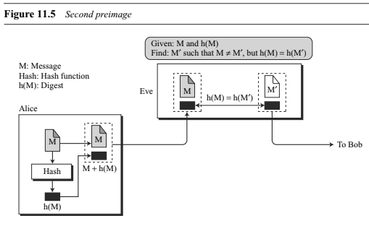

Slide 14
Collision Resistance
The third criterion, collision resistance, ensures that Eve cannot find two messages that hash to the same digest. Here the adversary can create two messages (out of scratch) and hashed to the same digest.
We will see later how Eve can benefit from this weakness in the hash function.
For the moment, suppose two different wills can be created that hash to the same digest.

Slide 15
When the time comes for the execution of the will, the second (forged) will is presented to the heirs.
Because the digest matches both wills, the substitution is undetected.
This type of attack is much easier to launch than the two previous kinds.
In other words, we need particularly be sure that a hash function is collision resistant.

Slide 16
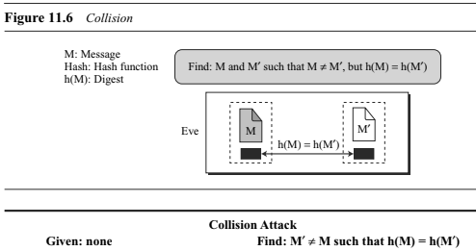

Slide 17
MESSAGE AUTHENTICATION
A message digest guarantees the integrity of a message.
It guarantees that the message has not been changed.
A message digest does not authenticate the sender of the message.
When Alice sends a message to Bob, Bob needs to know if the message is coming from Alice.
To provide message authentication, Alice needs to provide proof that it is Alice sending the message and not an impostor. A message digest cannot provide such a proof.

Slide 18
The digest created by a cryptographic hash function is normally called a modification detection code (MDC).
The code can detect any modification in the message.
What we need for message authentication (data origin authentication) is a message authentication code (MAC).

Slide 19
Modification Detection Code
A modification detection code (MDC) is a message digest that can prove the integrity of the message: that message has not been changed.
If Alice needs to send a message to Bob and be sure that the message will not change during transmission, Alice can create a message digest, MDC, and send both the message and the MDC to Bob.
Bob can create a new MDC from the message and compare the received MDC and the new MDC.
If they are the same, the message has not been changed.

Slide 20
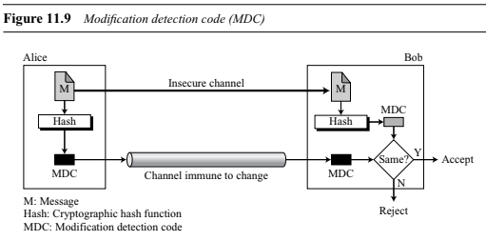

Slide 21
Message Authentication Code (MAC)
To ensure the integrity of the message and the data origin authentication that Alice is the originator of the message, not somebody else we need to change a modification detection code (MDC) to a message authentication code (MAC).
The difference between a MDC and a MAC is that the second includes a secret between Alice and Bob
For example, a secret key that Eve does not possess.

Slide 22
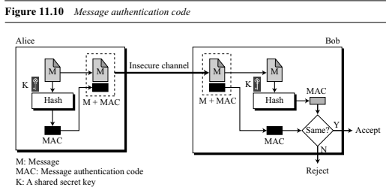

Slide 23
Alice uses a hash function to create a MAC from the concatenation of the key and the message, h (K|M).
She sends the message and the MAC to Bob over the insecure channel.
Bob separates the message from the MAC. He then makes a new MAC from the concatenation of the message and the secret key.
Bob then compares the newly created MAC with the one received.
If the two MACs match, the message is authentic and has not been modified by an adversary.

Slide 24
There is no need to use two channels in this case. Both message and the MAC can be sent on the same insecure channel.
Eve can see the message, but she cannot forge a new message to replace it because Eve does not possess the secret key between Alice and Bob.
She is unable to create the same MAC as Alice did.
This MAC is referred as a prefix MAC because the secret key is appended to the beginning of the message.
We can have a postfix MAC, in which the key is appended to the end of the message.
We can combine the prefix and postfix MAC, with the same key or two different keys.
However, the resulting MACs are still insecure.

Slide 25
Security of a MAC
Suppose Eve has intercepted the message M and the digest h(K|M).
How can Eve forge a message without knowing the secret key?
There are three possible cases:
1. Eve may prepend all possible keys at the beginning of the message and make a digest of the (K|M) to find the digest equal to the one intercepted. She then knows the key and can successfully replace the message with a forged message of her choosing.

Slide 26
2. The size of the key is normally very large in a MAC, but Eve can use another tool: the preimage attack. She uses the algorithm until she finds X such that h(X) is equal to the MAC she has intercepted. She now can find the key and successfully replace the message with a forged one. Because the size of the key is normally very large for exhaustive search, Eve can only attack the MAC using the preimage algorithm.
3. Given some pairs of messages and their MACs, Eve can manipulate them to come up with a new message and its MAC.

Slide 27
The security of a MAC depends on the security of the underlying hash algorithm.
Security of MAC
Nested MAC
In which hashing is done in two steps. In the first step, the key is concatenated with the message and is hashed to create an intermediate digest. In the second step, the key is concatenated with the intermediate digest to create the final digest.

Slide 28
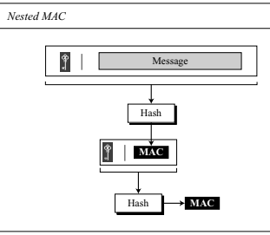

Slide 29
HMAC
NIST has issued a standard (FIPS 198) for a nested MAC that is often referred to as HMAC (hashed MAC, to distinguish it from CMAC).
The implementation of HMAC is much more complex than the simplified nested MAC.
There are additional features, such as padding.

Slide 30
We go through the steps:
The message is divided into N blocks, each of b bits.
The secret key is left-padded with 0’s to create a b-bit key. Note that it is recommended that the secret key (before padding) be longer than n bits, where n is the size of the HMAC.
The result of step 2 is exclusive-ored with a constant called ipad (input pad) to create a b-bit block. The value of ipad is the b/8 repetition of the sequence 00110110 (36 in hexadecimal).
The resulting block is prepended to the N-block message. The result is N + 1 blocks.
The result of step 4 is hashed to create an n-bit digest. We call the digest the intermediate HMAC.

Slide 31
6. The intermediate n-bit HMAC is left padded with 0s to
make a b-bit block.
7. Steps 2 and 3 are repeated by a different constant opad
(output pad). The value of opad is the b/8 repetition of
the sequence 01011100 (5C in hexadecimal).
8. The result of step 7 is prepended to the block of step 6.
9. The result of step 8 is hashed with the same hashing
algorithm to create the final n-bit HMAC.

Slide 32
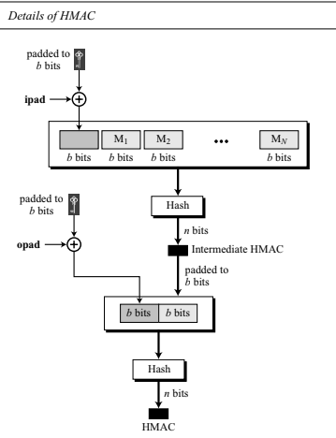

Slide 33
CMAC
NIST has also defined a standard (FIPS 113) called Data Authentication Algorithm, or CMAC, or CBCMAC.
The idea is to create one block of MAC from N blocks of plaintext using a symmetric-key cipher N times.
The message is divided into N blocks, each m bits long. The size of the CMAC is n bits.
If the last block is not m bits, it is padded with a 1-bit followed by enough 0-bits to make it m bits.

Slide 34
The first block of the message is encrypted with the symmetric key to create an m-bit block of encrypted data.
This block is XORed with the next block and the result is encrypted again to create a new m-bit block.
The process continues until the last block of the message is encrypted.
The n leftmost bit from the last block is the CMAC.
In addition to the symmetric key, K, CMAC also uses another key, k,which is applied only at the last step.

Slide 35
This key is derived from the encryption algorithm with plaintext of m 0-bits using the cipher key, K.
The result is then multiplied by x if no padding is applied and multiplied by x² if padding is applied.
The multiplication is in GF(2^{m}) with the irreducible polynomial of degree m selected by the particular protocol used.
Here the intermediate encrypted blocks are not sent as ciphertext;they are only used to be XORed with the next block.

Slide 36
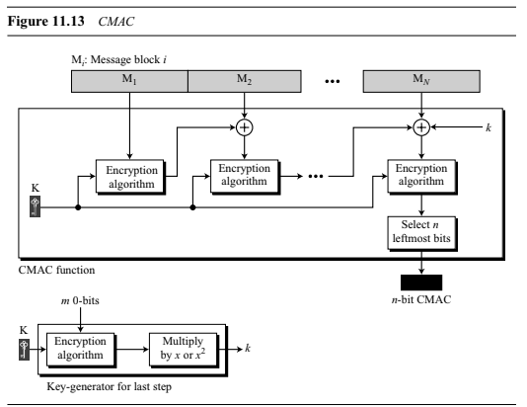

Slide 37
Iterated Hash Function
All cryptographic hash functions need to create a fixed-size digest out of a variable-size message.
Creating such a function is best accomplished using iteration.
Instead of using a hash function with variable-size input, a function with fixed-size input is created and is used a necessary number of times.
The fixed-size input function is referred to as a compression function.
It compresses an n-bit string to create an m-bit string where n is normally greater than m.
The scheme is referred to as an iterated cryptographic hash function.

Slide 38
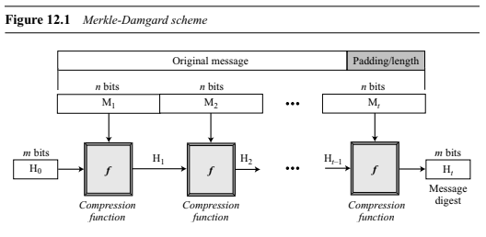
Merkle-Damgard Scheme
The Merkle-Damgard scheme is an iterated hash function that is collision resistant if the compression function is collision resistant.

Slide 39
The scheme uses the following steps:
1. The message length and padding are appended to the message to create an augmented message that can be evenly divided into blocks of n bits, where n is the size of the block to be processed by the compression function.
2. The message is then considered as t blocks, each of n bits. We call each block M1, M2,..., Mt. We call the digest created at t iterations H1, H2,..., Ht.
3. Before starting the iteration, the digest H0 is set to a fixed value, normally called IV (initial value or initial vector).

Slide 40
4. The compression function at each iteration operates on Hi−1 and Mi to create a new Hi. In other words, we have
Hi= ƒ(Hi−1, Mi),
where ƒ is the compression function.
5. Ht is the cryptographic hash function of the original message, that is, h(M).

Slide 41
The Merkle-Damgard scheme is the basis for many cryptographic hash functions today.
The only thing we need to do is design a compression function that is collision resistant and insert it in the Merkle-Damgard scheme.
There are two different approaches in designing a hash function.
The compression function is made from scratch: it is particularly designed for this purpose.
In the second approach, a symmetric-key block cipher serves as a compression function.

Slide 42
MD5
A set of cryptographic hash functions uses compression functions that are made from scratch.
Message Digest (MD): Several hash algorithms were designed by Ron Rivest. These are referred to as MD2, MD4, and MD5, where MD stands for Message Digest.
The last version, MD5, is a strengthened version of MD4 that divides the message into blocks of 512 bits and creates a 128-bit digest.
It turned out that a message digest of size 128 bits is too small to resist collision attack.

Slide 43
MD2
128-bit message digest:
Arbitrary number of bytes of message
First pad to multiple of 16 bytes
Append MD2 checksum (16 bytes) to the end
The checksum is almost a MD, but not cryptographically secure by itself.
Process whole message
Notes:
43

Slide 44
MD2 Checksum
One byte at a time, k × 16 steps
m_{nk}: byte nk of message
c_{n}=π(m_{nk} ⊕ c_{n-1}) ⊕ c_{n}
π : 0 → 41, 1 → 46, …
Substitution on 0-255 (value of the byte)
Notes:
44

Slide 45
MD2 Final Pass
Operate on 16-byte chunks
48-byte quantity q:
(current digest|chunk|digest⊕chunk)
18 passes of massaging over q, and one byte at a time:
c_{n}=π(c_{n-1}) ⊕ c_{n} for n = 0, … 47; c₋₁ = 0 for pass 0; c₋₁ = (c₄₇ + pass #) mod 256
After pass 17, use first 16 bytes as new digest
16 × 8 = 128
Notes:
45

Slide 46

MD5: Message Digest Version 5
input Message
Output 128 bits Digest
Notes:
46

Slide 47
MD5 Box
512-bit message chunks (16 words)
Initial
128-bit vector
128-bit result
Notes:
47

Slide 48
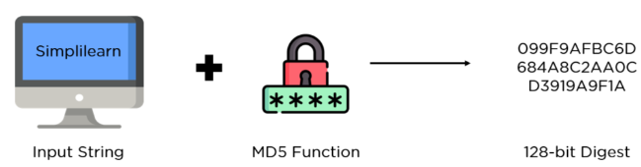
MD5 (Message Digest Method 5) is a cryptographic hash algorithm that generates a 128-bit digest from a string of any length.
The digests are represented as 32-digit hexadecimal numbers.

Slide 49
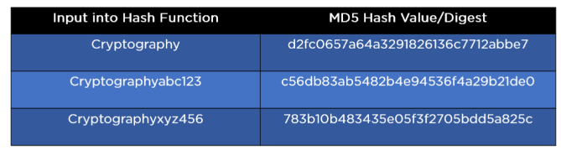
The digest size is always 128 bits, and thanks to hashing function guidelines, a minor change in the input string generates a drastically different digest.
This is essential to prevent similar hash generation, also known as a hash collision, as much as possible.

Slide 50
In cryptography, MD5 ensures data integrity and authenticity by generating unique hash values for distinct data inputs.
It converts arbitrary-sized data into a fixed-size 128-bit hash, making it crucial for applications like digital signatures, certificate generation, and data integrity verification.
By producing a consistent hash for the same input and different hashes for even minor changes in input, MD5 helps detect data corruption and tampering.
However, due to vulnerabilities like collision attacks, where different inputs produce the same hash, MD5 has diminished in favor of more secure algorithms like SHA-256 for critical cryptographic applications.

Slide 51
How Does MD5 Algorithm Work
The MD5 algorithm working process involves padding, appending length, initializing variables, processing in 512-bit blocks, and producing the final hash.
Step 1: Padding the Input
The first step in the MD5 algorithm involves padding the input message so its length (in bits) is congruent to 448 modulo 512. This is done by appending a single '1' bit followed by enough '0' bits to reach the required length, ensuring the total message length is a multiple of 512 bits.

Slide 52
Step 2: Appending the Length
After padding, the length of the original message (before padding) is appended as a 64-bit value. This step ensures that the original message length is still embedded within the hash input, even if the padded message length is manipulated.
Step 3: Initializing Variables
MD5 uses four 32-bit variables, which are initialized to specific constants. These variables, often denoted as A, B, C, and D, are set to the following values in hexadecimal:
A = 0x67452301
B = 0xefcdab89
C = 0x98badcfe
D = 0x10325476

Slide 53
Step 4: Processing in 512-bit Blocks
The padded message is processed in chunks of 512-bit blocks, each divided into sixteen 32-bit words. The main algorithm operates on each block in four rounds of 16 operations each, totaling 64 operations.
Step 5: Main Loop
The core of the MD5 algorithm involves four non-linear functions (F, G, H, and I) and four rounds of transformation. Each function takes three 32-bit words as input and produces a 32-bit output. The operations are performed as follows:
Round 1: Uses the function F(B,C,D)=(B&C)∣((∼B)&D)F(B, C, D) = (B \& C) | ((\sim B) \& D)F(B,C,D)=(B&C)∣((∼B)&D)
Round 2: Uses the function G(B,C,D)=(B&D)∣(C&(∼D))G(B, C, D) = (B \& D) | (C \& (\sim D))G(B,C,D)=(B&D)∣(C&(∼D))

Slide 54
Round 3: Uses the function H(B,C,D)=B⊕C⊕DH(B, C, D) = B \oplus C \oplus DH(B,C,D)=B⊕C⊕D
Round 4: Uses the function I(B,C,D)=C⊕(B∣(∼D))I(B, C, D) = C \oplus (B | (\sim D))I(B,C,D)=C⊕(B∣(∼D))
The algorithm performs a series of bitwise operations, modular additions, and left rotations in each round. Each operation modifies one of the four variables (A, B, C, D) using a different word from the block and a constant derived from the sine function.
Step 6: Producing the Final Hash
After all the 512-bit blocks have been processed, the final hash value is produced by concatenating the variables A, B, C, and D. The resulting 128-bit value is the MD5 hash of the input message.

Slide 55
MD5 algorithm
Padding –
length is 64 bit less than an integer multiple of 512 bits.
If 448(64 bit less than 512) then padding is ? N
1000 ? Y (1472 64 less 1536 = 3*512)
512 ? Y
Append length –
64 bit length of msg , len mod 2⁶⁴ , data to hash = [Msg + padding +len]
Initialize MD buffer – chaining variable A,B,C,D – 32 bit no
Process message in 512 bit blocks –
Four rounds of processing on
i/p 512 bit data divided into 16 blocks of 32 bit each X[i]
chaining variable
uses one fourth of element table T[1---64] constructed from sin function 2^32 * abs(sin(i))\
process g (different for each round) F,G,H,I

Slide 56
MD5: Padding
1
2
3
4
input Message
512 bit block
Padding
Initial Value
MD5
Transformation block by block
Output 128 bits Digest
Final Output
Notes:
56

Slide 57
MD5 Blocks
512: B₁
512: B₂
MD5
512: B₃
MD5
512: B₄
MD5
MD5
Result
Notes:
57

Slide 58
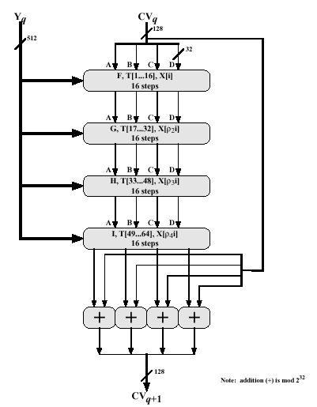
Step 4. Continued (4 Rounds)
58

Slide 59
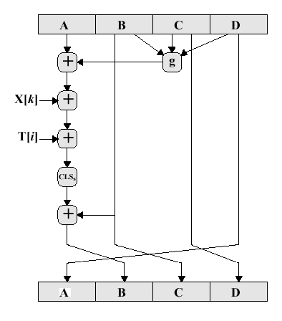
Step 4. Continued
59

Slide 60
Applications of MD5 Algorithm
Data Integrity
Digital Signatures
Certificate Generation and Verification
Password Storage
Checksums and File Integrity

Slide 61
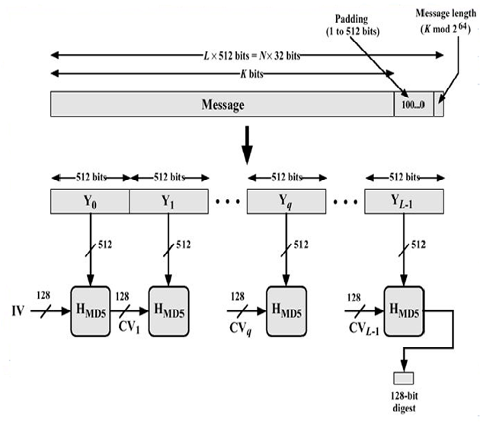

Slide 62
SHA-1
Secure Hash Algorithm (SHA)
The Secure Hash Algorithm (SHA) is a standard that was developed by the National Institute of Standards and Technology (NIST) and published as a Federal Information Processing standard (FIP 180).
It is sometimes referred to as Secure Hash Standard (SHS). The standard is mostly based on MD5.
The standard was revised in 1995 under FIP 180-1, which includes SHA-1.
It was revised later under FIP 180-2, which defines four new versions: SHA-224, SHA-256, SHA-384, and SHA-512.

Slide 63
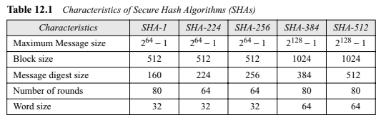

Slide 64
SHA-1 Hash
SHA-1 or Secure Hash Algorithm 1 is a cryptographic algorithm that takes an input and produces a 160-bit (20-byte) hash value.
This hash value is known as a message digest.
This message digest is usually then rendered as a hexadecimal number which is 40 digits long.
It is a U.S. Federal Information Processing Standard and was designed by the United States National Security Agency.
SHA-1 is been considered insecure since 2005.
Major tech giants browsers like Microsoft, Google, Apple, and Mozilla have stopped accepting SHA-1 SSL certificates by 2017.

Slide 65
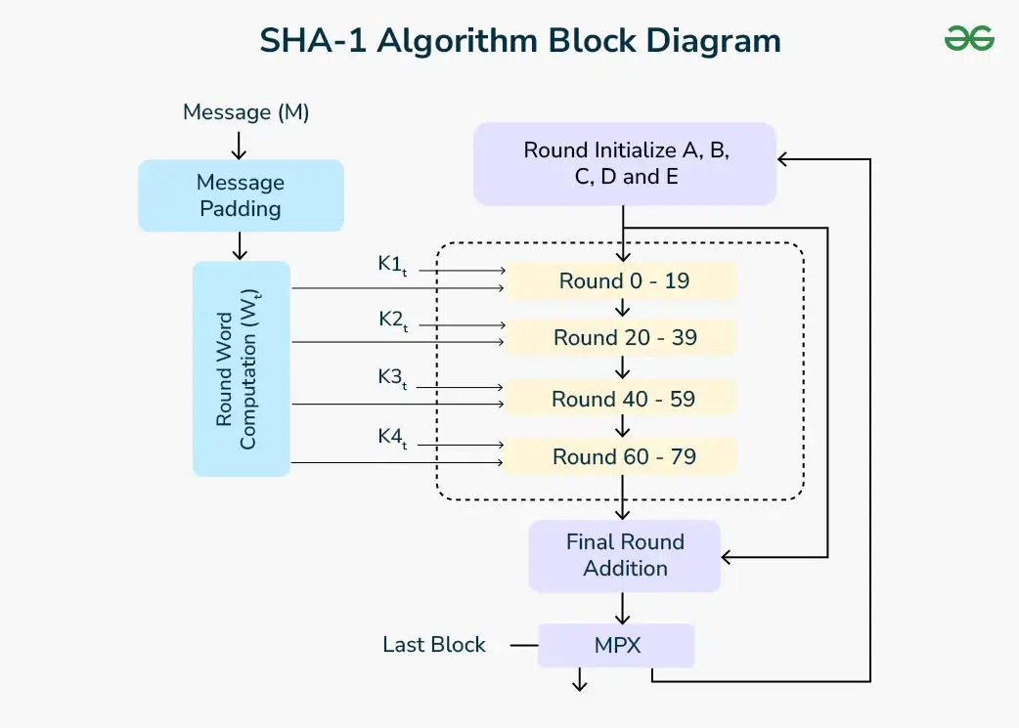

Slide 66
How SHA-1 Works
Message (M):
The original input message that needs to be hashed.
Message Padding:
The initial step where the message is padded to ensure its length is congruent to 448 modulo 512. This step prepares the message for processing in 512-bit blocks.
Round Word Computation (WtW_tWt​):
After padding, the message is divided into blocks of 512 bits, and each block is further divided into 16 words of 32 bits. These words are then expanded into 80 32-bit words, which are used in the subsequent rounds.

Slide 67
4. Round Initialize (A, B, C, D, and E):
Initialization of five working variables (A, B, C, D, and E) with specific constant values. These variables are used to compute the hash value iteratively.
5. Round Constants (KtK_tKt​):
SHA-1 uses four constant values (K1K_1K1​, K2K_2K2​, K3K_3K3​, K4K_4K4​), each applied in a specific range of rounds:
K1K_1K1​ for rounds 0-19
K2K_2K2​ for rounds 20-39
K3K_3K3​ for rounds 40-59
K4K_4K4​ for rounds 60-79

Slide 68
7. Rounds (0-79):
The main computation loop of SHA-1, divided into four stages (each corresponding to one of the constants K1K_1K1​ to K4K_4K4​). In each round, a combination of logical functions and operations is performed on the working variables (A, B, C, D, and E) using the words generated in the previous step.
8. Final Round Addition:
After all 80 rounds, the resulting values of A, B, C, D, and E are added to the original hash values to produce the final hash.
9. MPX (Multiplexing):
Combines the results from the final round addition to form the final message digest.

Slide 69
Summary of Steps:
Input (Message M): The process starts with the input message MMM.
Message Padding: The message is padded to meet the length requirements.
Word Computation: The padded message is divided into blocks and further into words, which are expanded for use in the rounds.
Initialization: Initial hash values are set.
Round Processing: The main loop performs 80 rounds of computation using the message words and round constants.
Final Addition: The results from the rounds are added to the initial hash values.
Output (Hash Value): The final message digest is produced.

Slide 70
General Logic
Input message must be < 2⁶⁴ bits
not really a problem
Message is processed in 512-bit blocks sequentially
Message digest is 160 bits
SHA design is similar to MD5, but a lot stronger

Slide 71
Basic Steps
Step1: Padding
Step2: Appending length as 64 bit unsigned
Step3: Initialize MD buffer 5 32-bit words
A|B|C|D|E – big indian format
A = 67452301
B = efcdab89
C = 98badcfe
D = 10325476
E = c3d2e1f0

Slide 72
Basic Steps...
Step 4: the 80-step processing of 512-bit blocks – 4 rounds, 20 steps each.
Each step t (0 <= t <= 79):
Input:
W_{t} – a 32-bit word from the message
K_{t} – a constant.
ABCDE: current MD.
Output:
ABCDE: new MD.

Slide 73
Basic Steps...
Only 4 per-round distinctive additive constants
0 <=t<= 19 K_{t} = 5A827999
20<=t<=39 K_{t} = 6ED9EBA1
40<=t<=59 K_{t} = 8F1BBCDC
60<=t<=79 K_{t} = CA62C1D6

Slide 74
Basic Steps - The Heart Of The Matter
A
B
C
D
E
+
f_{t}
+
CLS5
W_{t}
+
CLS30
K_{t}
+
A
B
C
D
E

Slide 75
Basic Logic Functions
Only 3 different functions
Round Function f_{t}(B,C,D)
0 <=t<= 19 (B∧C)∨(~B ∧D)
20<=t<=39 B⊕C⊕D
40<=t<=59 (B∧C)∨(B∧D)∨(C∧D)
60<=t<=79 B⊕C⊕D

Slide 76
PKI
Public Key Infrastructure (PKI)
Public key infrastructure is an important aspect of internet security.
It is the set of technology and processes that make up a framework of encryption to protect and authenticate digital communications.
PKI uses cryptographic public keys that are connected to a digital certificate, which authenticates the device or user sending the digital communication.

Slide 77
Digital certificates are issued by a trusted source, a certificate authority (CA), and act as a type of digital passport to ensure that the sender is who they say they are.
Public key infrastructure protects and authenticates communications between servers and users, such as between your website (hosted on your web server) and your clients (the user trying to connect through their browser.
ensure that the messages are only visible It can also be used for secure communications within an organization to to the sender and recipient, and they have not been tampered with in transit.

Slide 78
The main components of public key infrastructure include the following:
Certificate authority (CA): The CA is a trusted entity that issues, stores, and signs the digital certificate. The CA signs the digital certificate with their own private key and then publishes the public key that can be accessed upon request.
Registration authority (RA): The RA verifies the identity of the user or device requesting the digital certificate. This can be a third party, or the CA can also act as the RA.
Certificate database: This database stores the digital certificate and its metadata, which includes how long the certificate is valid.

Slide 79
Central directory: This is the secure location where the cryptographic keys are indexed and stored.
Certificate management system: This is the system for managing the delivery of certificates as well as access to them.
Certificate policy: This policy outlines the procedures of the PKI. It can be used by outsiders to determine the PKI’s trustworthiness.

Slide 80
How PKI works
Public key infrastructure uses asymmetric encryption methods to ensure that messages remain private and also to authenticate the device or user sending the transmission.
Asymmetric encryption involves the use of a public and private key. A cryptographic key is a long string of bits used to encrypt data.
The public key is available to anyone who requests it and is issued by a trusted certificate authority. This public key verifies and authenticates the sender of the encrypted message.

Slide 81
The second component of a cryptographic key pair used in public key infrastructure is the private, or secret, key. This key is kept private by the recipient of the encrypted message and used to decrypt the transmission.
Complex algorithms are used to encrypt and decrypt public/private key pairs. The public key authenticates the sender of the digital message, while the private key ensures that only the recipient can open and read it.

Slide 82
PKI certificates
The core of a public key infrastructure is trust.
It is important for a recipient entity to know without a doubt that the sender of the digital certificate is exactly who they claim to be.
Trusted third-party CAs can vouch for the sender and help to prove that they are indeed who they say they are. Digital certificates are used to verify digital identities.
Digital certificates are also called PKI certificates or X.509 certificates. A PKI certificate offers proof of identity to a requesting entity, which is verified by a third party and works like a digital passport or driver’s license.

Slide 83
The PKI certificate will contain the following:
Distinguished name (DN) of the owner
Owner’s public key
Date of issuance
Expiration date
DN of the issuing CA
Issuing CA’s digital signature

Slide 84
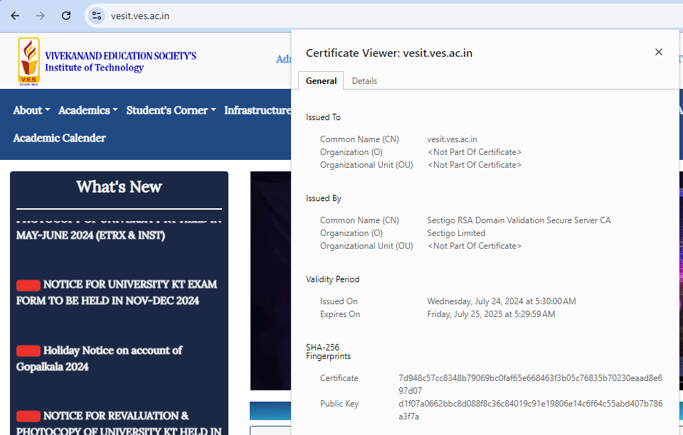

Slide 85
Why is PKI used
TLS/SSL (transport layer security/secure socket layer), which secures encrypted HTTP (hypertext transfer protocol) communications.
Email encryption and authentication of the sender
Signing documents and software
Using database servers to secure internal communications
Securing web communications, such as e-commerce
Authentication and encryption of documents
Securing local networks and smart card authentication
Encrypting and decrypting files
Restricted access to VPNs and enterprise intranets
Secure communication between mutually trusted devices such as IoT (internet of things) devices

Slide 86
X.509 Authentication Service/Digital Certificate
Difference between Digital Signature and Digital Certificate
Digital signatures and Digital Certificates both are security solutions that may protect your data from cyber thieves.
Although these words have some similarities, they have entirely different synonyms and purposes.
A digital signature is an attachment to an electronic document which may be considered a signature.
When a document is allocated, the data may not be modified without invalidating the signature.
The document is encrypted with the signer's key to form the digital signature.

Slide 87
In contrast, a digital certificate is a way to demonstrate the identity of the holder for a specific electronic transaction.
It protects the data exchange from visitors to the website and certifies the individuals or websites.

Slide 88
Digital certificate
Digital certificates, also known as identity certificates or public key certificates, are a form of electronic password using the public key infrastructure (PKI) that allows individuals and organizations to exchange data over the internet in a secure manner.
A digital certificate uses cryptography and a public key to prove the authenticity of a server, device, or user, ensuring that only trusted devices can connect to an organization’s network. They can also be used to confirm the authenticity of a website to a web browser.

Slide 89
A website, organization, or individual can request a digital certificate that will then need to be validated by a publicly trusted certificate authority (CA).
Digital certificates can help to keep communications, data, and websites secure on the internet.
There are some potential weaknesses for exploitation with digital certificates, but websites secured by these public key certificates are considered more secure than those that are not.

Slide 90
Public key certificates are issued by trusted third parties, a CA, who signs the certificate, thus verifying the identity of the device or user that is requesting access.
To ensure validity, the public key will be matched with a corresponding private key that only the recipient has knowledge of.
Digital certificates have a specific key pair that they are associated with: one public and one private.

Slide 91
A digital certificate contains the following identifiable information:
User’s name
Company or department of user
IP (internet protocol) address or serial number of device
Copy of the public key from a certificate holder
Duration of time the certificate is valid for
Domain certificate is authorized to represent

Slide 92
Digital certificates can provide the following benefits:
Security: Digital certificates can keep internal and external communications confidential and protect the integrity of the data. It can also provide access control, ensuring only the intended recipient receives and can access the data.
Authentication: With a digital certificate, users can be sure that the entity or person they are communicating with is who they say they are and makes sure that communications reach only the intended recipient.
Scalability: Digital certificates can be used across a variety of platforms for individuals and large and small businesses alike.

Slide 93
They can be issued, renewed, and revoked in a matter of seconds. They can be used to secure a range of user devices and be managed through one centralized system.
Reliability: A digital certificate can only be issued by a publicly trusted and rigorously vetted CA, meaning that they cannot be easily tricked or faked.
Public trust: The use of a digital certificate proves authenticity of a website, documents, or emails. It can assure users and clients that the company or individual is genuine and respects privacy and values security.

Slide 94
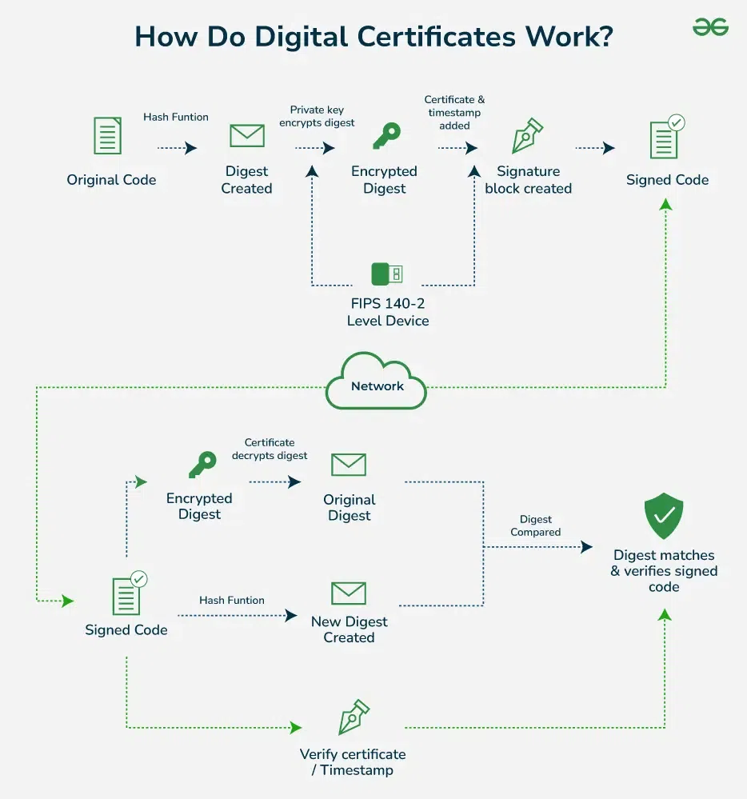
How Do
Digital
Certificates
Work

Slide 95
Different types of digital certification
There are three main types of public key certificates:
TLS/SSL (Transport Layer Security/Secure Sockets Layer) certificates,
client certificates,
and code signing certificates.
There are also variations within each type of certificate.

Slide 96
Extended Validation: This provides comprehensive business authentication, which is necessary for handling extremely sensitive data for businesses or larger organizations. Businesses in the financial sector usually employ it because it provides the highest degree of trust, security, and authenticity.
Client Certificate: A client certificate is a digital identity that uniquely identifies a person to another user, computer, or machine to another. Email is a typical example of this, in which the sender digitally signs a message, and the receiver verifies the signature. This is the most effective way to verify the certificates.

Slide 97
Code Signing Certificate: This is required to verify the legitimacy of software or files obtained from the internet. When consumers download software, the developer or publisher signs it as proof that it is authentic. For software companies that provide their products on external websites, this is a helpful way to demonstrate that the files remain unaltered.
TLS/SSL Certificate: A program, mail, or web server, for example, uses a TLS/SSL certificate to guarantee and secure encrypted and confidential communication with its customers. The certificate gives the server the authentication it needs to transmit and receive encrypted communications to clients.

Slide 98
Domain Validated: Any website can use a quick validation technique that works with a domain-verified certificate. It is inexpensive to get and is ready to use in a few minutes.

Slide 99
How are Digital Certificates Used
Securing Websites: Digital certificates help secure websites by enabling HTTPS. This ensures that the information you send to and receive from the website is private and secure.
Email Security: They encrypt emails to keep the contents private and use digital signatures to confirm who sent the email and that it hasn’t been changed.
Software Safety: Developers use digital certificates to prove that their software is genuine and hasn’t been tampered with since it was released.
Verifying Identities: Digital certificates confirm the identity of the users or devices trying to access a secure system, like a company’s internal network.

Slide 100
Signing Documents: They are used to digitally sign documents like contracts or official forms, verifying the signer’s identity and ensuring the document hasn’t been altered.
IoT Device Security: In the Internet of Things, digital certificates authenticate devices and secure the data they send and receive.
Smart Card Authentication: They are embedded in smart cards, used for secure logins and personal identification, combining something you have (the card) with something you know (a PIN).

Slide 101
X.509 Authentication Service
X.509 digital certificate is a certificate-based authentication security framework that can be used for providing secure transaction processing and private information.
These are primarily used for handling the security and identity in computer networking and internet-based communications.

Slide 102
Working of X.509 Authentication Service Certificate
The core of the X.509 authentication service is the public key certificate connected to each user.
These user certificates are assumed to be produced by some trusted certification authority and positioned in the directory by the user or the certified authority.
These directory servers are only used for providing an effortless reachable location for all users so that they can acquire certificates.
With the help of Abstract Syntax Notation, the X.509 certificate format uses an associated public and private key pair for encrypting and decrypting a message.

Slide 103
Once an X.509 certificate is provided to a user by the certified authority, that certificate is attached to it like an identity card.
The chances of someone stealing it or losing it are less, unlike other unsecured passwords.
With the help of this analogy, it is easier to imagine how this authentication works: the certificate is basically presented like an identity at the resource that requires authentication.

Slide 104
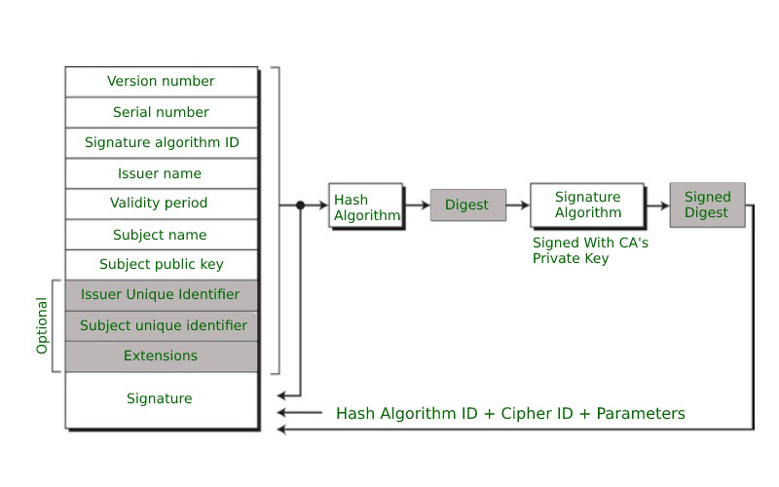
Format of X.509 Authentication Service Certificate

